Slide 1
Understanding requirements
PART-1

Slide 2
contents
Requirements Engineering
Requirements Analysis
Elements Of Requirements Engineering
Classification Of Requirements
Functional Requirements
Non-functional Requirements
Use Case Diagram
Use Case Description

Slide 3
Requirements engineering
Requirements Engineering
Requirements are statements of what the system must do, how it must behave, the properties it must exhibit, the qualities it must possess, and the constraints that the system and its development must satisfy.
Requirements Analysis
specifies software’s operational characteristics
indicates software's interface with other system elements
establishes constraints that software must meet

Slide 4
Contd.
Inception—ask a set of questions that establish …
basic understanding of the problem
the people who want a solution
the nature of the solution that is desired, and
the effectiveness of preliminary communication and collaboration between the customer and the developer
Elicitation—elicit requirements from all stakeholders
Elaboration—create an analysis model that identifies data, function and behavioral requirements
Negotiation—agree on a deliverable system that is realistic for developers and customers

Slide 5
Contd.
Specification—can be any one (or more) of the following:
a written document
a set of models
a formal mathematical
a collection of user scenarios (use-cases)
a prototype
Validation—a review mechanism that looks for
errors in content or interpretation
areas where clarification may be required
missing information
inconsistencies (a major problem when large products or systems are engineered)
conflicting or unrealistic (unachievable) requirements.
Requirements management

Slide 6
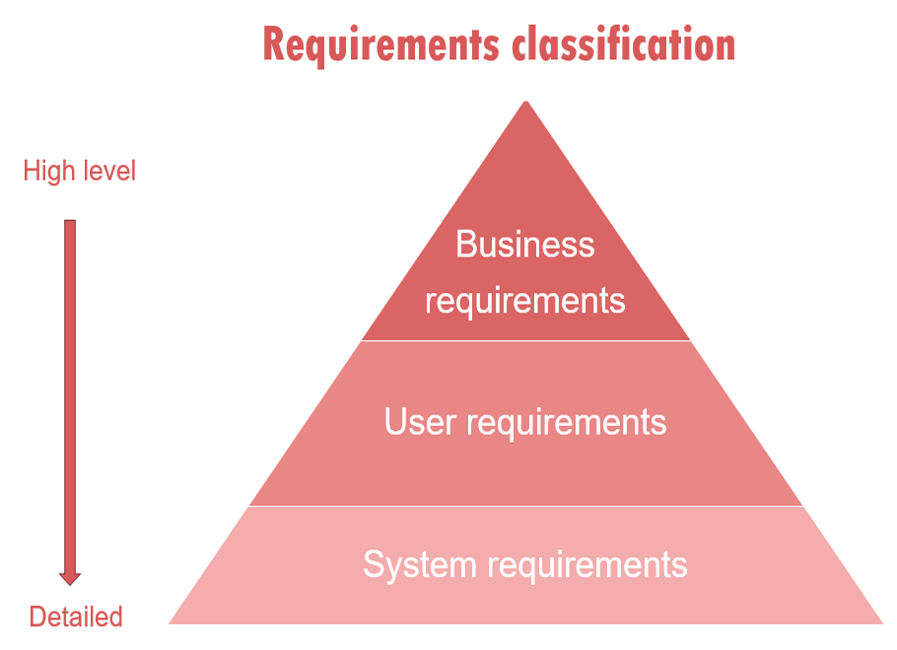
Classification of requirements

Slide 7
Contd.
Business Requirements. These include high-level statements of goals, objectives, and needs.
Stakeholder Requirements. The needs of discrete stakeholder groups are also specified to define what they expect from a particular solution.
Solution Requirements. Solution requirements describe the characteristics that a product must have to meet the needs of the stakeholders and the business itself.
Nonfunctional requirements describe the general characteristics of a system. they are also known as quality attributes.
Functional requirements describe how a product must behave, what its features and functions.
Transition Requirements. An additional group of requirements defines what is needed from an organization to successfully move from its current state to its desired state with the new product.

Slide 8
Functional requirements
Functional requirements describe system behavior under specific conditions and include the product features and functions which web & app developers must add to the solution. such requirements should be precise both for the development team and stakeholders.
The list of examples of functional requirements includes:
business rules
transaction corrections, adjustments, and cancellations
administrative functions
authentication
authorization levels
audit tracking
external interfaces
certification requirements
reporting requirements
historical data

Slide 9
Example of functional requirements
Here, are some examples of non-functional requirement:
the software automatically validates customers against the ABC contact management system
the sales system should allow users to record customers sales
the background color for all windows in the application will be blue and have a hexadecimal RGB color value of 0x0000ff.
only managerial level employees have the right to view revenue data.
the software system should be integrated with banking API
the software system should pass section 508 accessibility 9 requirement

Slide 10
NONfunctional requirements
A non-functional requirement defines the quality attribute of a software system. they represent a set of standards used to judge the specific operation of a system. example, how fast does the website load?
Some typical non-functional requirements are:
performance– for example response time, throughput, utilization, static volumetric
capacity
availability
reliability
recoverability
Maintainability
serviceability
security
regulatory
manageability
environmental
Data integrity
usability

Slide 11
Example of Nonfunctional requirements
here, are some examples of non-functional requirement:
users must change the initially assigned login password immediately after the first successful login. moreover, the initial should never be reused.
employees never allowed to update their salary information. such attempt should be reported to the security administrator.
every unsuccessful attempt by a user to access an item of data shall be recorded on an audit trail.
a website should be capable enough to handle 20 million users with affecting its performance
the software should be portable. so moving from one os to other os does not create any problem.
privacy of information, the export of restricted technologies, intellectual property rights, etc. should be audited

Slide 12
Elements of analysis model
Elements of the analysis model
Scenario-based elements
functional—processing narratives for software functions
use-case—descriptions of the interaction between an “actor” and the system
Class-based elements
implied by scenarios
Behavioral elements
state diagram
Flow-oriented elements
data flow diagram

Slide 13
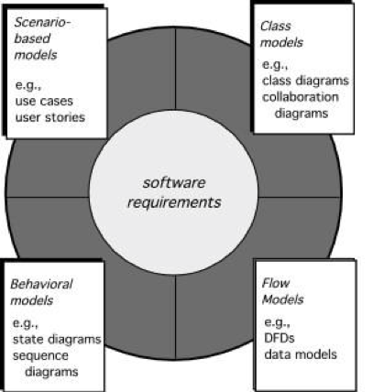
Elements of requirement analysis

Slide 14
USE cases
Use cases describe the interaction between the system and external users that leads to achieving particular goals.
Each use case includes three main elements:
Actors. these are the users outside the system that interact with the system.
System. the system is described by functional requirements that define an intended behavior of the product.
Goals. the purposes of the interaction between the users and the system are outlined as goals.
There are two formats to represent use cases:
Use case specification/description
Use case diagram

Slide 15
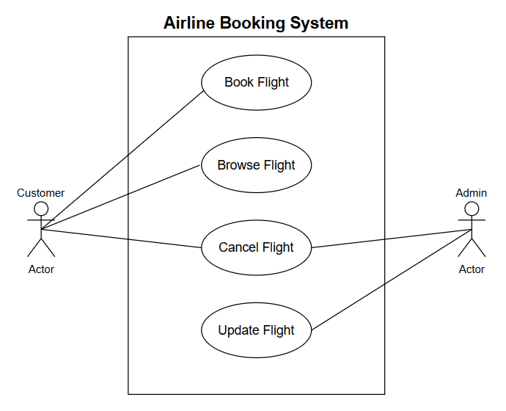
Actors
An actor can be primary or secondary.
Primary actors are those that initiate use cases and interact with the system.
They are usually placed on the left side of the system.
Secondary actors are used by the system but they do not interact with the system on their own.
they are displayed on the right side of the system.
Actors are represented by figures.

Slide 16
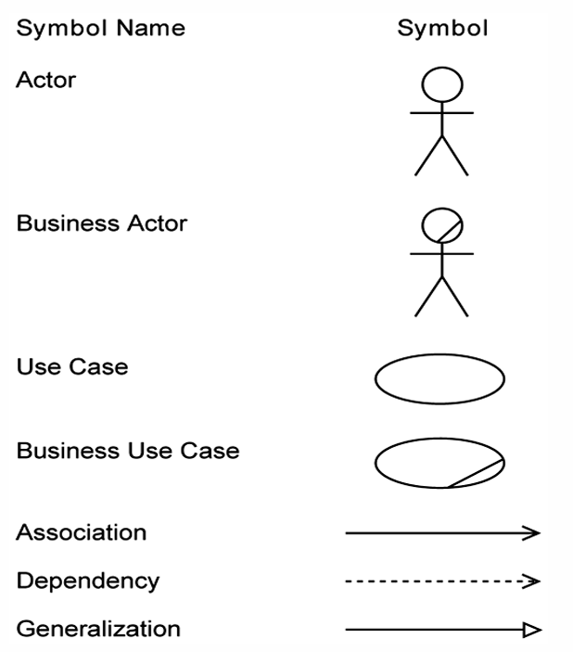
Use case elements

Slide 17
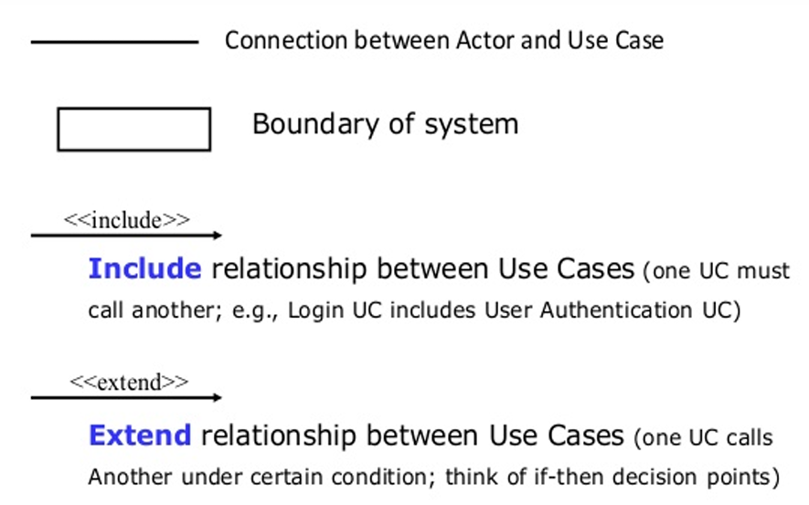
CONTD.

Slide 18
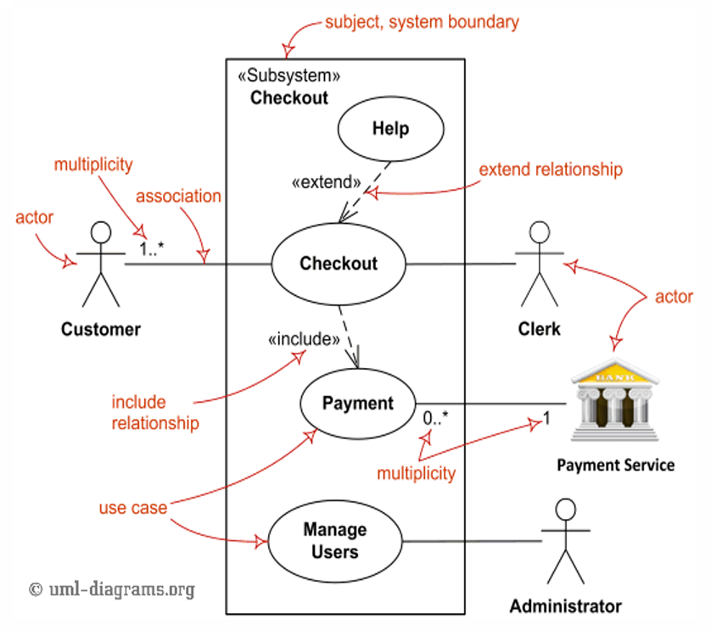

Slide 19
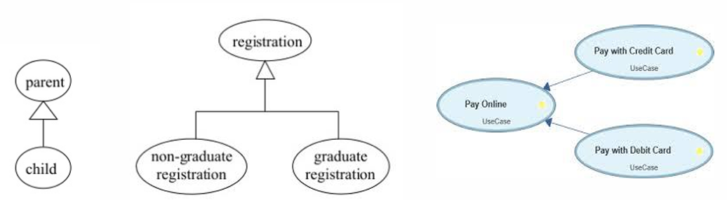
Use case generalization
The child use case inherits the behavior meaning of the parent use case
The child may add to or override the behavior of its parent.

Slide 20
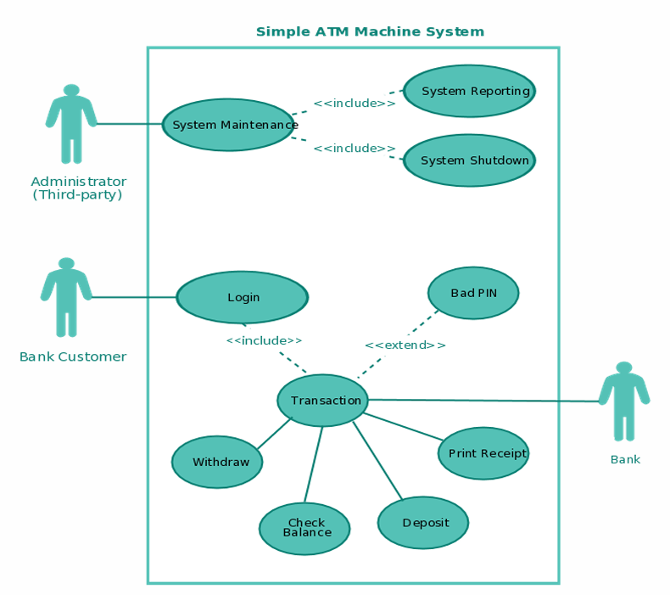

Slide 21
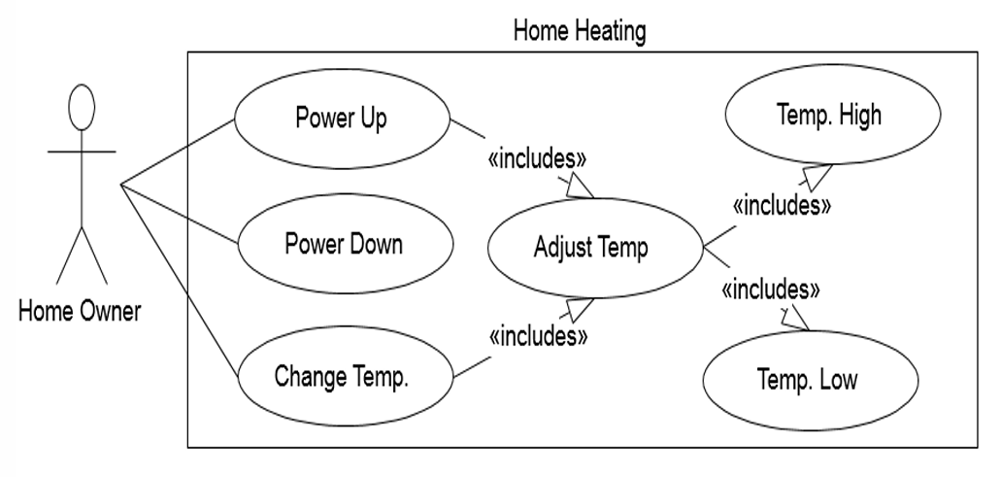
Home heating system

Slide 22
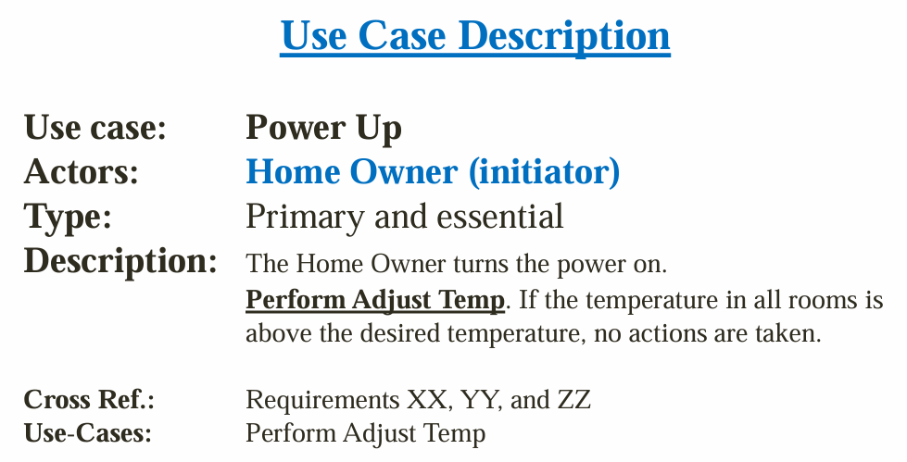
Contd.

Slide 23
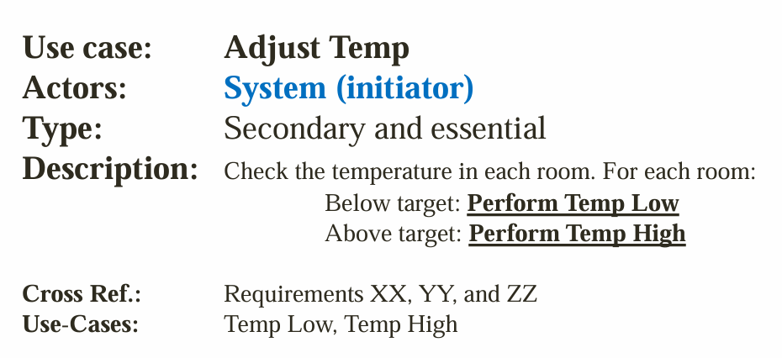
Contd.

Slide 24
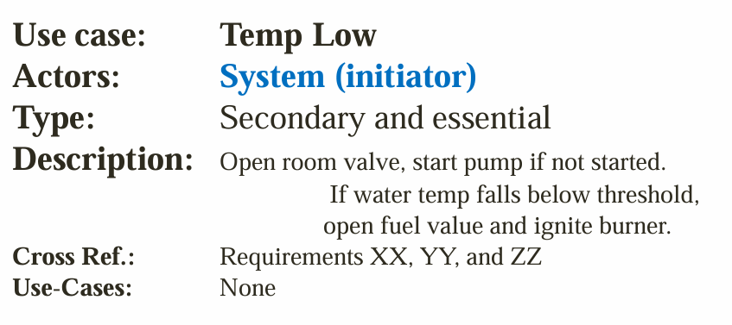
Contd.

Slide 25
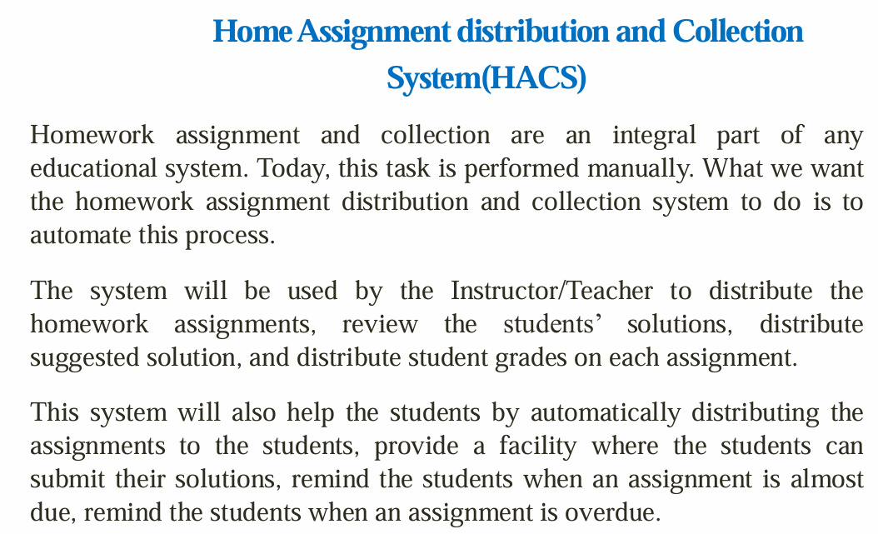

Slide 26
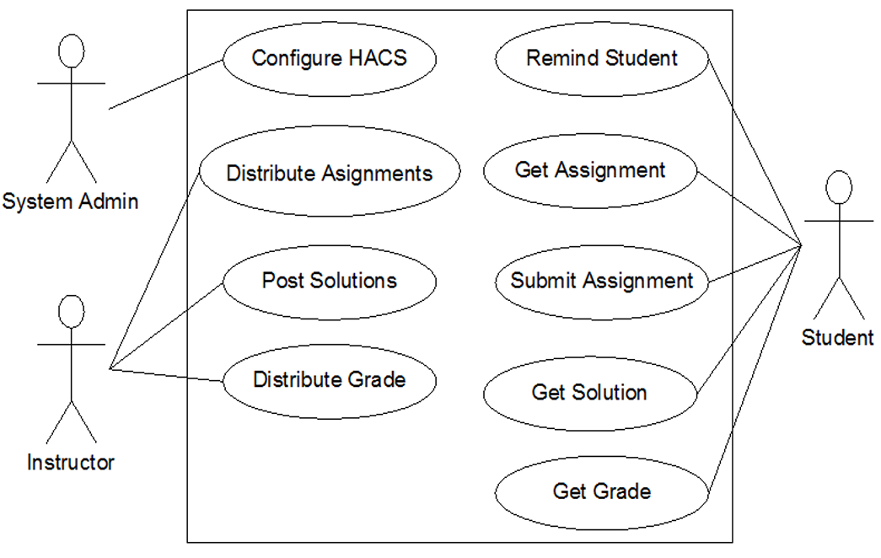

Slide 27
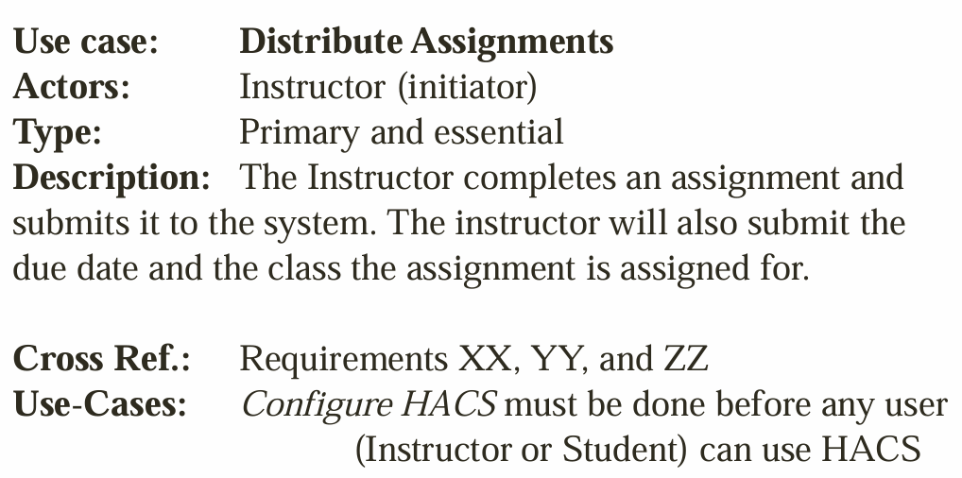

Slide 28
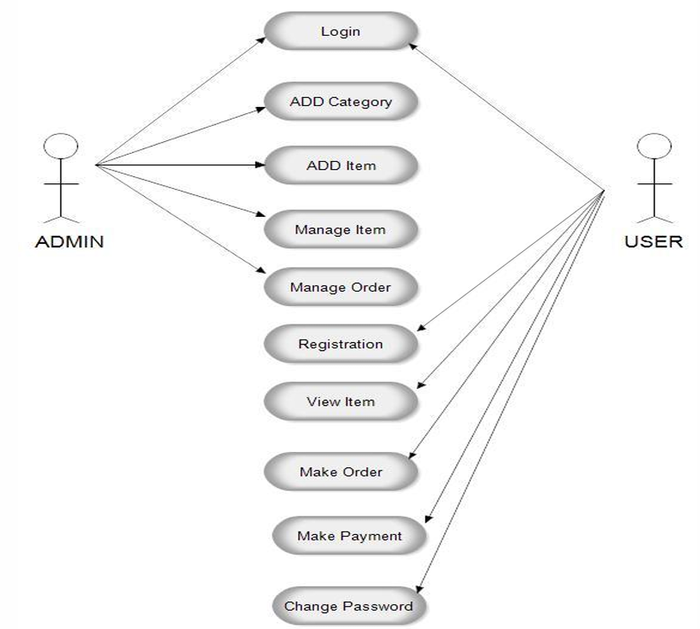

Slide 29
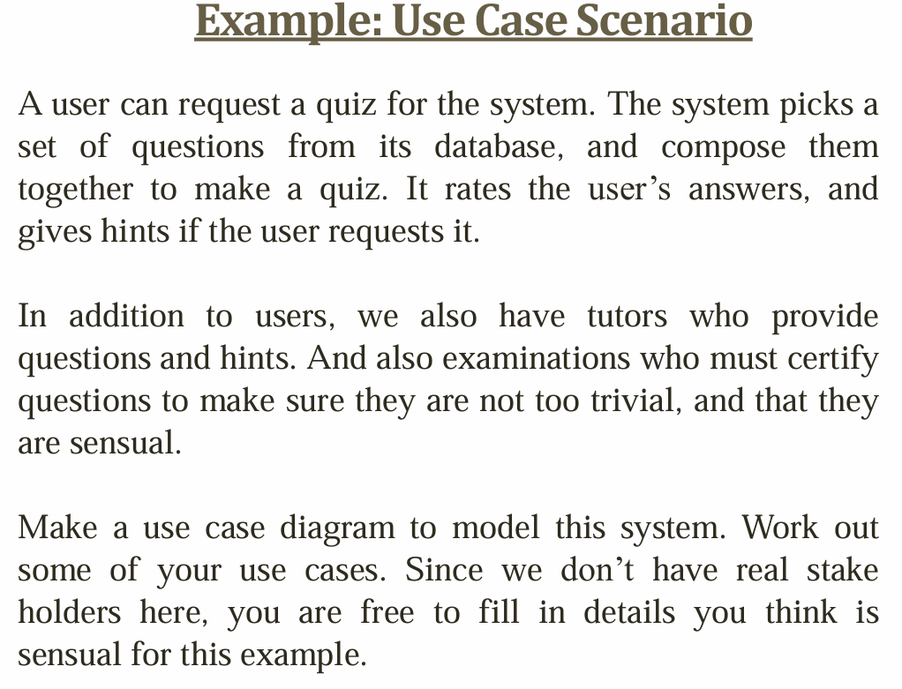

Slide 30
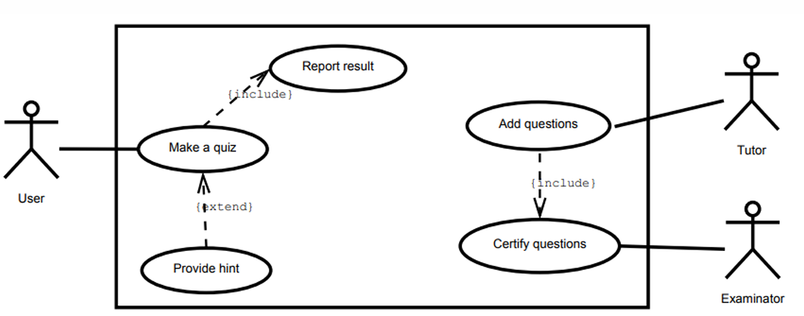

Slide 31
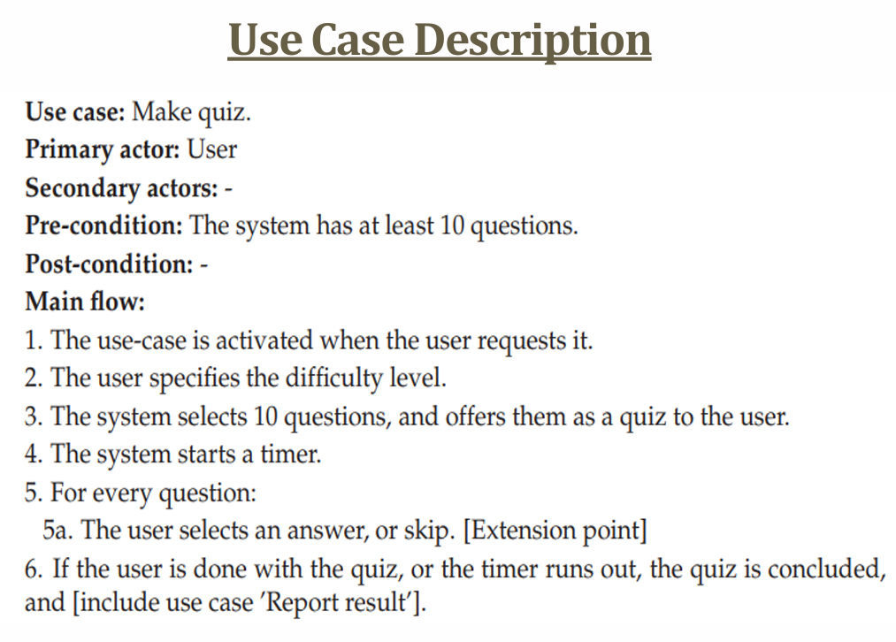

Slide 32
Do it Yourself!!!
Suppose we want to develop software for an alarm clock.
The clock shows the time of day. using buttons, the user can set the hours and minutes fields individually, and choose between 12 and 24-hour display.
It is possible to set one or two alarms. when an alarm fires, it will sound some noise. the user can turn it off, or choose to ’snooze’. if the user does not respond at all, the alarm will turn off itself after 2 minutes. ’snoozing’ means to turn off the sound, but the alarm will fire again after some minutes of delay. this ’snoozing time’ is pre-adjustable.
Identify the top-level functional requirement for the clock, and model it with a use case diagram.

Slide 33
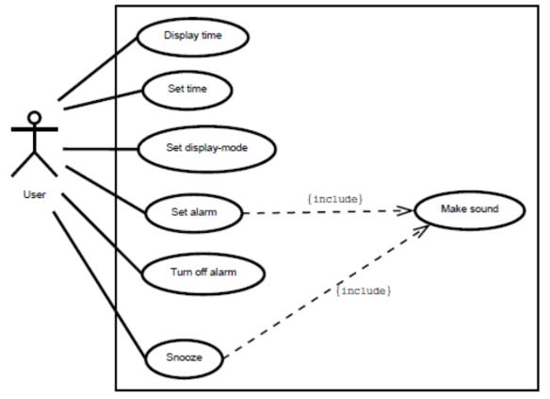

Slide 34
Thank you!!!

